Slide 1
BG Distribution Training Centre
Electrified Hardware 1

Slide 2
Electrified Hardware System Components
Required Components
Load
Power
Switch
Conductor
Optional Components
Monitor
www.bgdistribution.ca

Slide 3
Power
Power Source for the System
Power Supply
Transformer
Battery
www.bgdistribution.ca

Slide 4
Conductor
Wire Run
Wire
Door Loop
Electric Hinge
Power Transfer Device
Electric Pivot
Electric Continuous Hinge
www.bgdistribution.ca

Slide 5
Switch
Control for the System
Card Access
Keypad
Motion Sensor
Key Switch
Pushbutton
Request to Exit Signal
Timer
etc.
www.bgdistribution.ca

Slide 6
Load
Electric Locking Devices
Electric Strike
Electrified lock
Electrified Exit Device
Electromagnetic Lock
Electromechanical Lock
Automatic Operator
www.bgdistribution.ca

Slide 7
Switch Operating Modes
Momentary
When pressed closes two contacts, when pressure removed opens two contacts
Maintained/Alternate Action
When pressed closes two contacts, when pressed again opens two contacts
Time Delay
When pressed closes two contacts for a period of time, then opens two contacts
www.bgdistribution.ca

Slide 8
Switch Terminology
Relay
An electrically controlled device that opens and closes electrical contacts to effect the operation od other devices in the same or another electric
Timer
Card Reader
Fire Alarm Relay
www.bgdistribution.ca

Slide 9
www.bgdistribution.ca

Slide 10
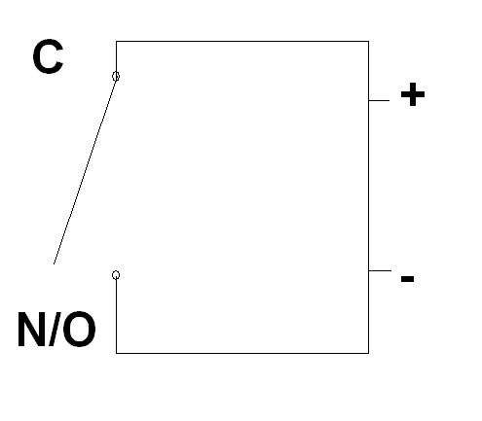
www.bgdistribution.ca

Slide 11
Relay Parts
Contacts
Negative (-)
Contacts
Positive (+)
www.bgdistribution.ca

Slide 12
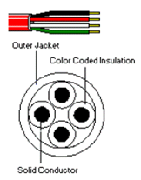
Electric Wiring
Size
Gauge
AWG – American Wire Gauge
www.bgdistribution.ca

Slide 13
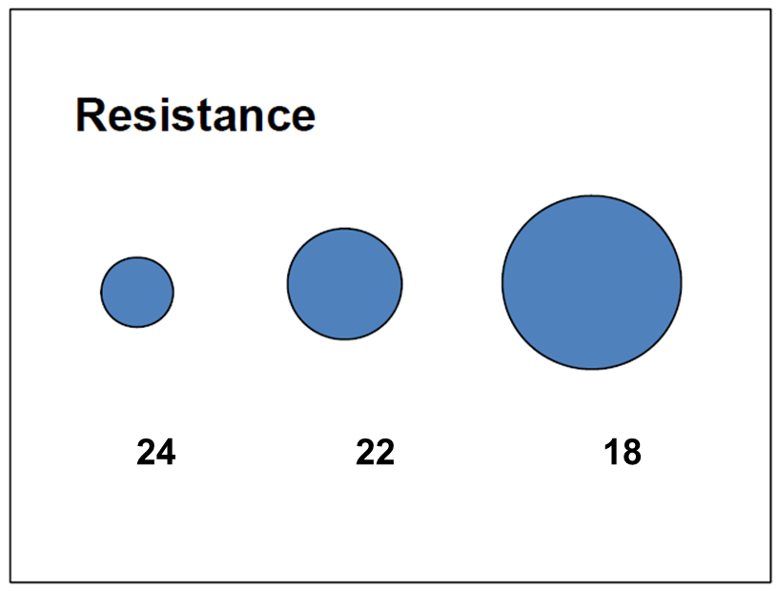
Wire Gauge
The larger the number the smaller the wire
www.bgdistribution.ca

Slide 14
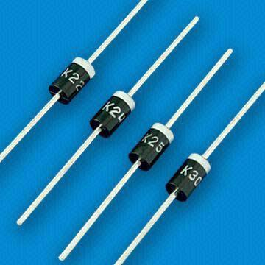
Switch Terminology
Diodes
Used for Spike Suppression
Electricity can only flow in one direction
4 Diodes make a rectifier
www.bgdistribution.ca

Slide 15
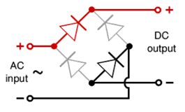
Rectifiers
Converts alternating current to direct current
www.bgdistribution.ca

Slide 16
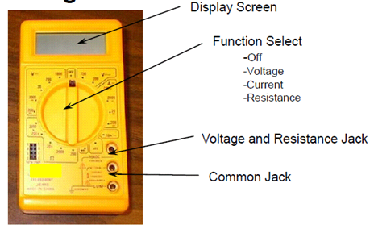
Volt Ohm Meter
Using Volt-Ohm Meters
V.O.M is the most important tool when it comes to troubleshooting
V.O.M can test for
Voltage- AC/DC
Shorts/Closed Circuits
Open Circuits
Ohms
Grounds
www.bgdistribution.ca

Slide 17
Volt Ohm Meter
VOM Testing for voltage
www.bgdistribution.ca

Slide 18
Volt Ohm Meter
VOM Testing for continuity
www.bgdistribution.ca

Slide 19
Volt Ohm Meter
VOM Testing for current
www.bgdistribution.ca

Slide 20
Training Courses
We offer the following training courses:
Mechanical Hardware 1
Basic Electrical Hardware 1
Mechanical Hardware 2
Electrical Hardware/Access Control 2
www.bgdistribution.ca

Slide 21
QUESTIONS
Ottawa (ON) 21-5370 Canotek Rd K1J 9E8 T: [613]748-7377 | 1 [888]607-0585 F: [613]748-0015 | Montréal (QC) 4500 rue Molson H1Y 0A3 T: [514]392-2555 | 1[888]819-2602 F: [514]392-1623 | 1[888]357-3820 | Québec (QC) 125 rue Fortin G1M 3M2 T: [418]682-5550 | 1[866]563-6785 F: [418]682-5522 | 1[866]563-6786 | Toronto (ON) 115 Sharer Road, #2 L4L 8Z3 T: [905]265-9449 | 1[855]488-5625 F: [905]265-1097 | 1[855]488-9700
www.bgdistribution.ca

